Slide 1
Data Collection in Apps
Presented by: Calvin, Rahul, Kiran, Azad

Slide 2
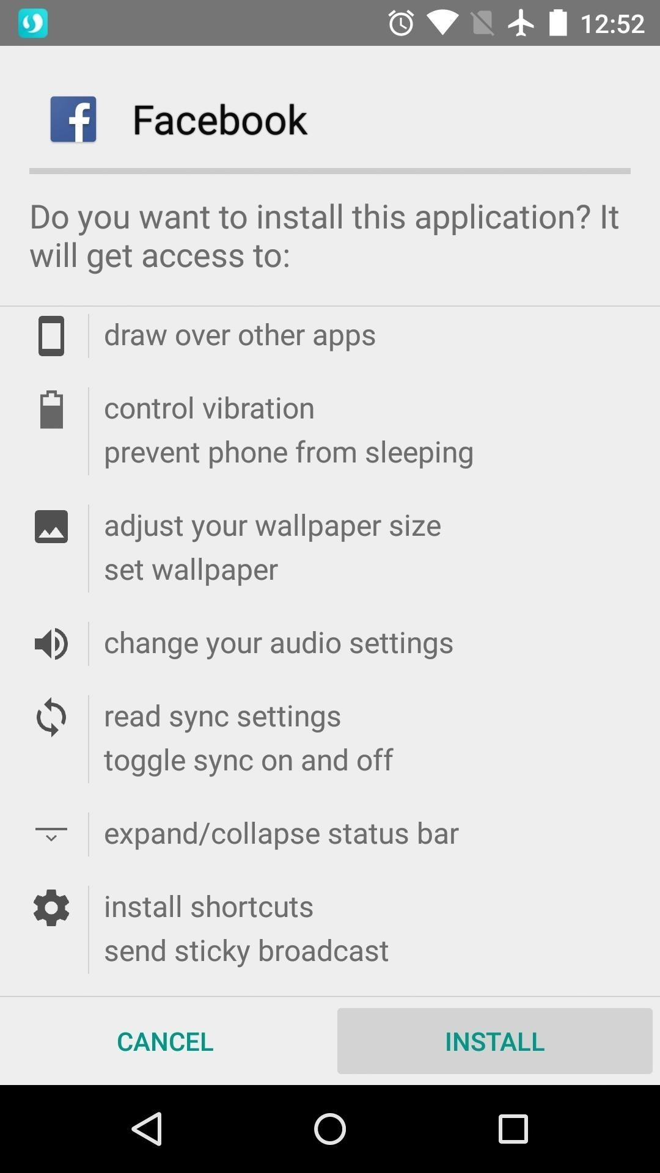
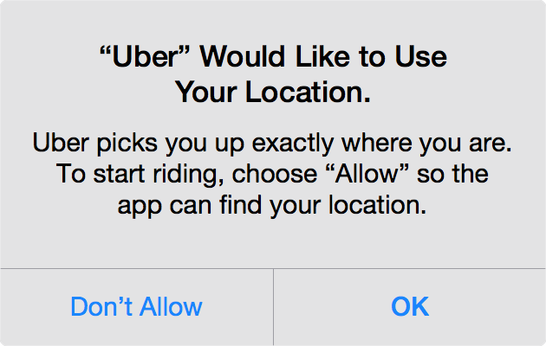
App Permissions
Once installing an app, it will ask for permission to use your device’s hardware.

Slide 3
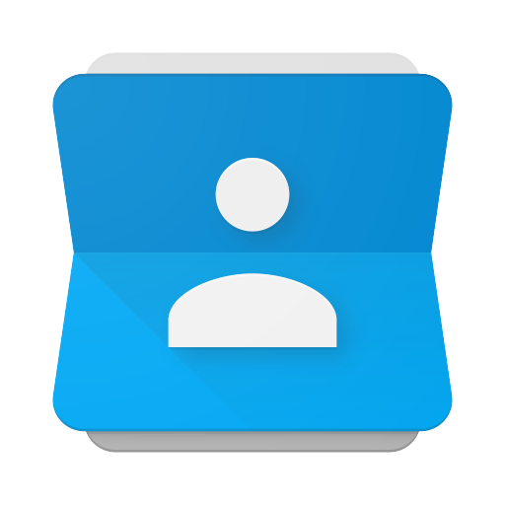

Importing Contacts
Some social media apps allows the user to use their contact list to add friends on the platform. The app can find out who are your friends

Slide 4
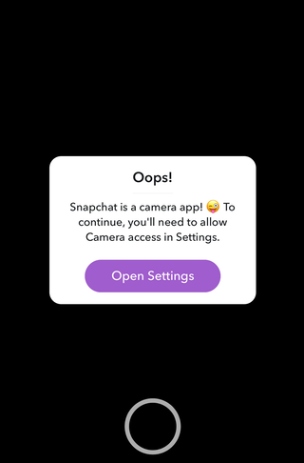
Camera and Gallery
Some apps may request camera and gallery access to use certain features, but it could use them in the background as well. Some apps need them to even function properly.

Slide 5
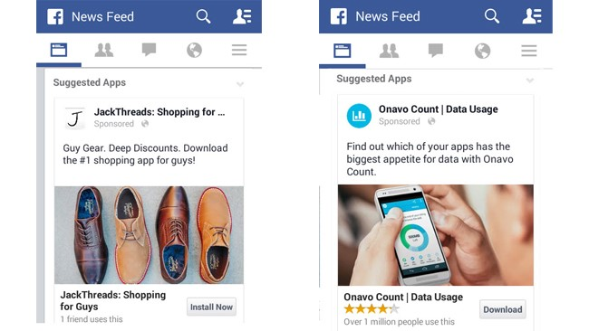
Interest/Likes
When you like a photo or follow a particular page, the social platform keeps record of all of that. This allows them to fine tune ads of which are most relatable to you.

Slide 6
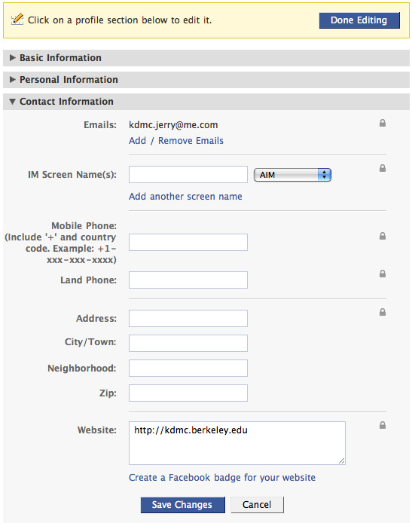
Profile Info
When you go to your Profile or Someone else profile you get to know there personal information, such as email, mobile number, City, your name, your Address and etc.

Slide 7
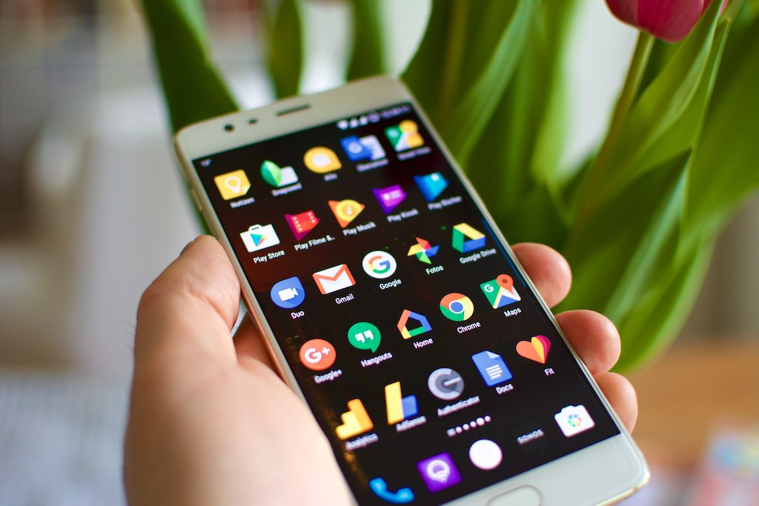
Google is an prime example of a user data collector
Since they own the most used search engine, Google is one of the world’s top data-rich companies.

